Slide 1
Modeling Wine Quality
BAna 7042 – Statistical Modeling

Slide 2
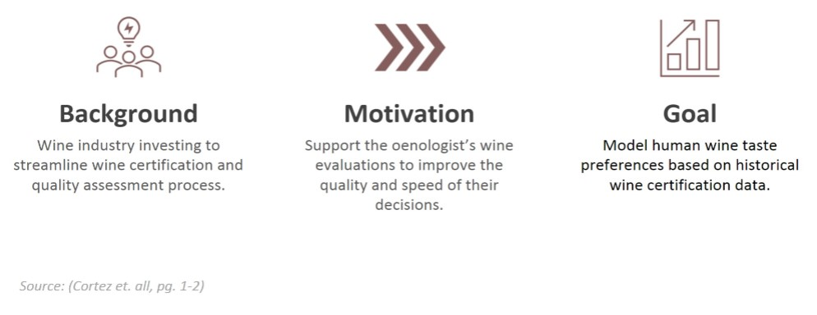
Introduction

Slide 3
The Variables
Acid that does not evaporate easily.
Acetic acid in wine.
Adds freshness in small quantities.
Sugar remaining after fermentation.
Salt in wine.
Free SO2 (microbial growth and oxidation prevention).
Free and bound forms of SO2
Dependent upon alcohol, sugar, and water content.
Describes acidity or basicity.
Contributes to SO2 – Antimicrobial and antioxidant.
Percentage alcohol content
Sensory score between 0 and 10.
Fixed Acidity
Volatile Acidity
Citric Acid
Residual Sugar
Chlorides
Free Sulfur Dioxide
Total Sulfur Dioxide
Density
pH
Sulphates
Alcohol
Quality

Slide 4

How can we understand what influences the quality of wine?
We would like to understanding how the chemical properties of wine affect our subjective experience of quality.
Can we use data collected from professional tasters to triangulate upon chemical properties which are characteristic of quality wines?
The article Modeling Wine preferences by data mining from physiochemical properties, 2009 by Paulo Cortez, Antonio Cerdeira, Fermando Almeida, Telmo Matos, and Jose Reis is the source of the data and preliminary information for this presentation.
Below is the first 5 observations from the Red Wine data set. The 12 attributes associated with each wine are fixed acidity, volatile acidity, citric acid, residual sugar, chlorides, free sulfur dioxide, total sulfur dioxide, density, PH, sulphates, alcohol, and quality.

Slide 5
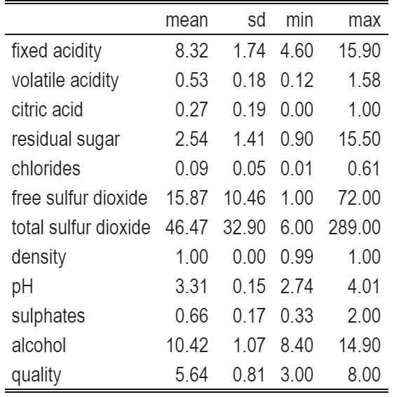
Summary Statistics Table
Initial Observations:
The sample size of this data is 1599,
There are no missing observations for any column.
12 Columns
Physiochemical Laboratory results
There are some outliers in this data.
Free Sulfur Dioxide
Total Sulfur Dioxide
Chlorides
Residual Sugar

Slide 6

Can We Predict Wine Quality?
COUNT BY SCORE
Poor
Excellent
Quality Score: The score is based upon the median value of 3 wine assessors via a blind taste test.
Concerns:
The extreme ends if the scale are absent or rare in our sample data set. We may be concerned that this is due to missing data, the affect of using median score, or bias within the data.
Could having a better picture of quality’s central tendency paint a better picture? (Mean, Median, Min, Max).
Only about 2/13 of our data are considered excellent. Is this too stringent of a requirement? There could be imbalance in our modeling as a result of this proportion.

Slide 7
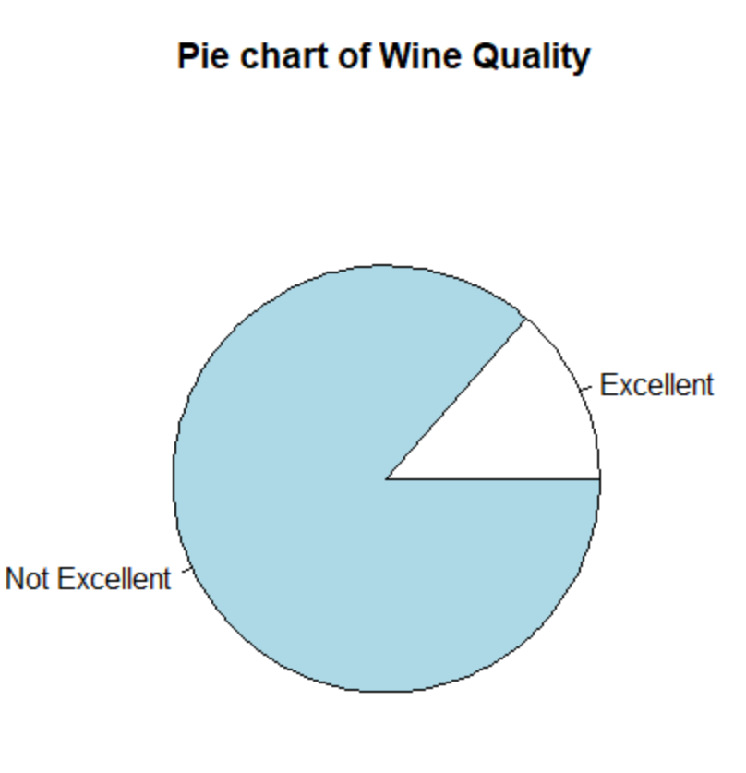
Proportion of Excellent Wines
Cutoff at a quality rating of 7.
2 separate classes
Excellent
Not Excellent.
217 wines of the 1599 had a quality of 7 or higher.
Around 2/13 proportion are excellent.
The bar set for an excellent wine is quite stringent.

Slide 8
Visualizing Excellent wine predictors
I have chosen to visualize the predictor variable’s impact on the classification of wines as Excellent or Not Excellent. I have done this by separating each predictor variables into 6 even groups based on the chemical saturation of each predictor variable from least to most and visualizing how the proportion of excellent wine changes across groups.
There are roughly 2 distinct categories of the predictor variables in how they relate to wine excellence: it is indicated by higher saturation or lower saturation. There are some which may do well on either extreme, in the middle, or have no apparent effect on the excellence categorization. I will just present the most significant from the first two categories I mentioned.

Slide 9
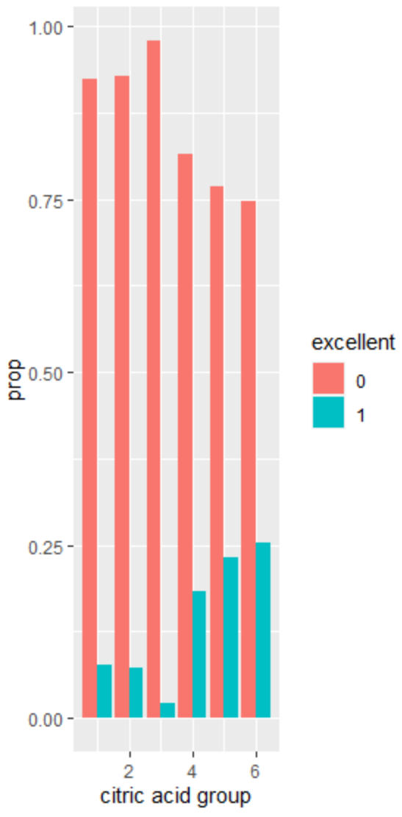
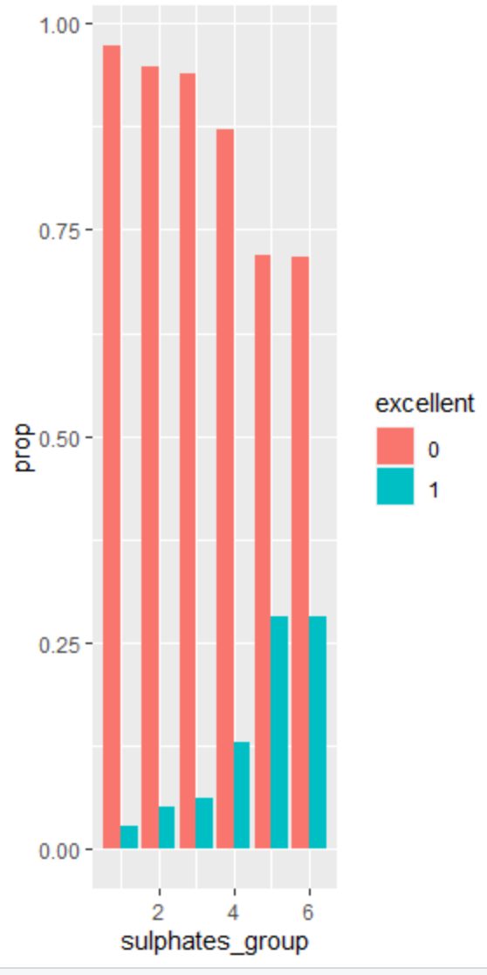
Higher Saturation Leads to Excellence
In the case of Citric Acid and Sulfates content, there is a clear pattern which indicated that a higher concentration of these chemicals in the wine leads to a greater proportion of these wines being classified as excellent.
Given this information, there is an inclination to believe that having higher concentrations of these chemicals in the wine could improve the perceived quality.

Slide 10
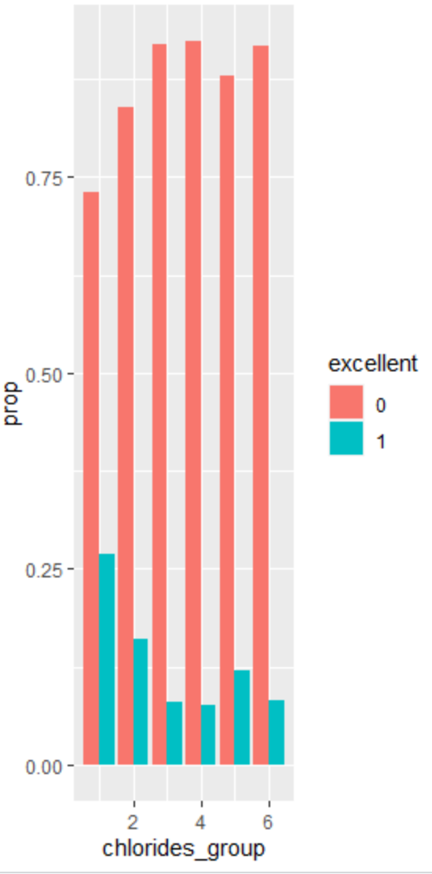
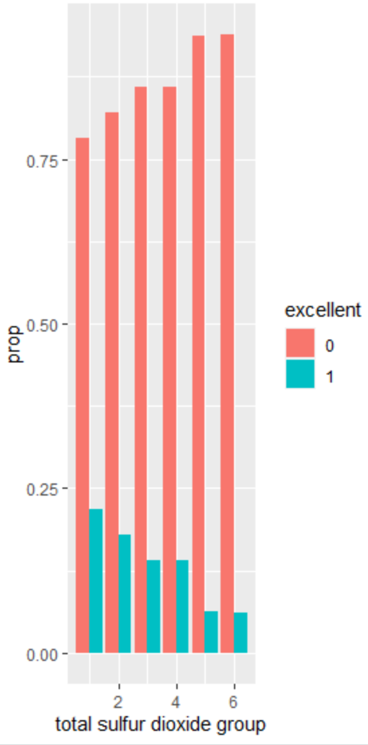
Lower Saturation Leads to Excellence
In the case of Chlorides and Total Sulfur Dioxide content, there is a clear pattern which indicated that a lower concentration of these chemicals in the wine leads to a greater proportion of these wines being classified as excellent.
Given this information, there is an inclination to believe that having lower concentrations of these chemicals in the wine could improve the perceived quality.

Slide 11
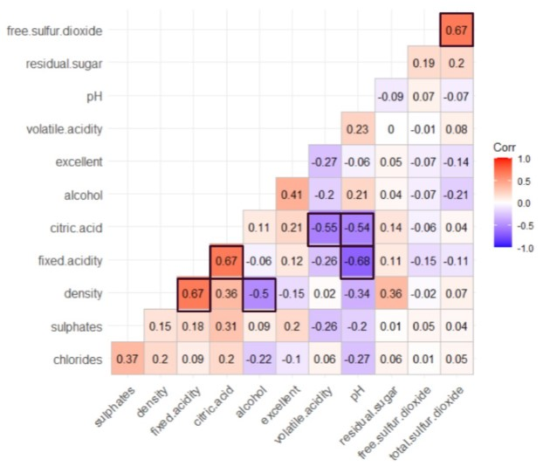
Correlation Matrix
Upon scanning the correlation matrix of our predictor variables, there is some concern with multicollinearity which could affect our future modeling.
Fixed Acidity has a strong positive correlation with Density and Citric Acid. Free Sulfur Dioxide and Total Sulfur Dioxide
Citric Acid has a strong negative correlation with Volatile Acidity and pH. Alcohol and Density – Fixed Acidity and pH also have a notably large negative correlation.

Slide 12
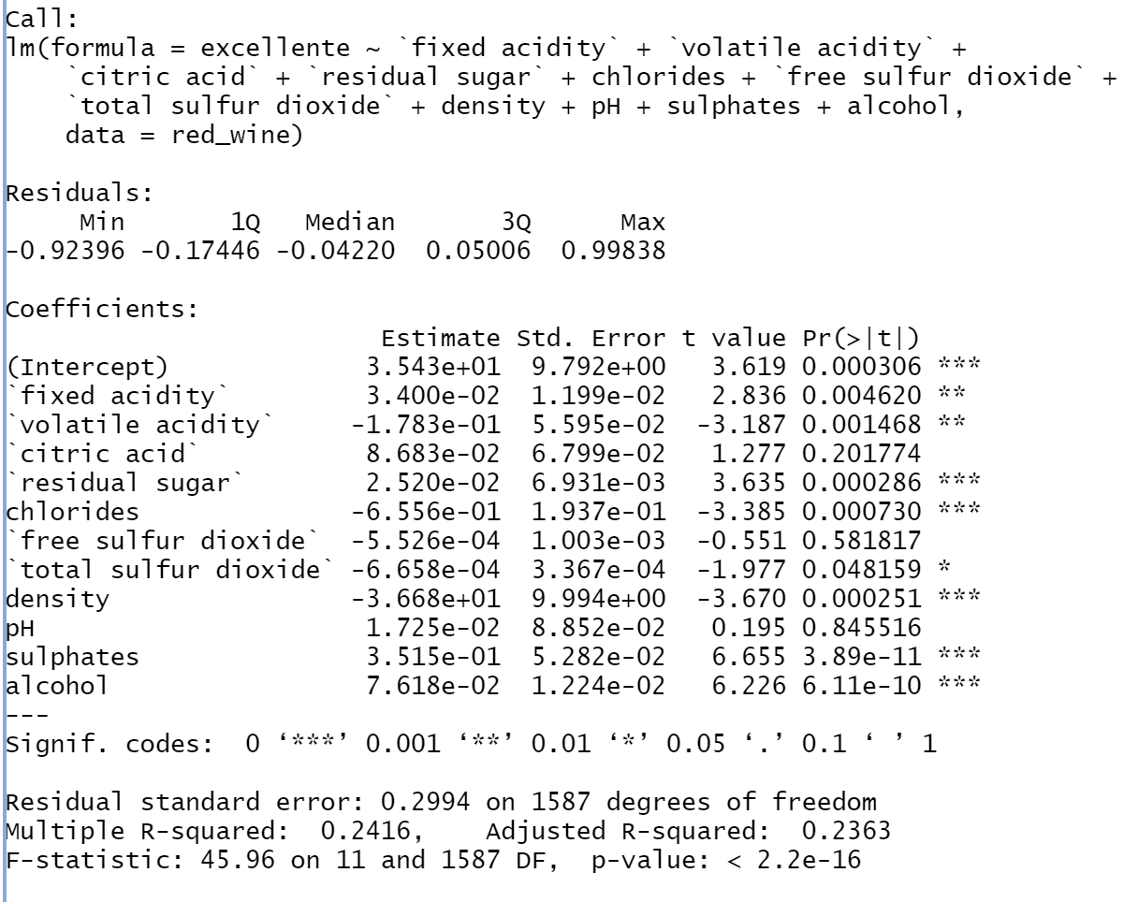
Linear Regression Model
The linear regression model created is significant in its capacity to predict wine excellence. The significant predictor variables were fixed acidity, volatile acidity, residual sugar, chlorides, total sulfur dioxide, density, sulphates, and alcohol. Each of these have a p-value below 0.05.
Among the significant indicators, the indicators which give a positive association with wine excellence are fixed acidity, residual sugar, sulphates, and alcohol. Volatile acidity, chlorides, total sulfur dioxide, and density all indicate a negative association with wine excellence.

Slide 13
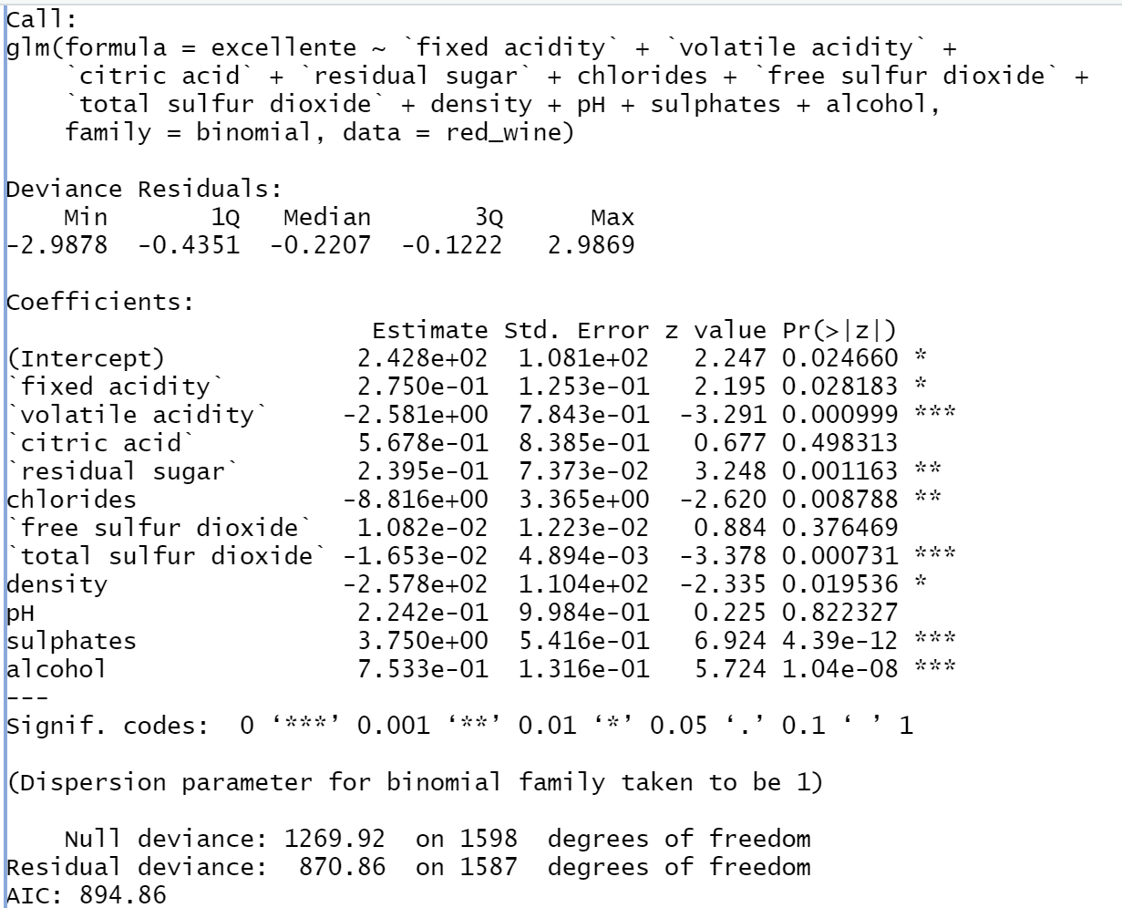
Logistic Regression Model
The logistic regression model created is significant in its capacity to predict wine excellence as a binary variable. The significant predictor variables were fixed acidity, volatile acidity, residual sugar, chlorides, total sulfur dioxide, density, sulphates, and alcohol. Each of these have a p-value below 0.05.
Among the significant indicators, the indicators which give a positive association with wine excellence are fixed acidity, residual sugar, sulphates, and alcohol. Volatile acidity, chlorides, total sulfur dioxide, and density all indicate a negative association with wine excellence.

Slide 14
Linear regression and Logistic Regression Comparison
The linear regression and logistic regression both produced linear models with the same significant predictor variables. Additionally, the predictor variables that had a positive association with quality in one had a positive association in the other and vice versa.
The models were unlike each other in the coefficient values and the degree of significance. The coefficients were larger or smaller for the intercept and each predictor variable and its corresponding level of significance.
This result makes sense, because they are both linear models. It would be unlikely for the variable coefficients to differ drastically given that most variables had a clear association with wine quality by our visualizations. We can expect, however, for the models to fill a different purpose, because the linear regression will predict a continuous data point while the logistic model will predict either a 0 or 1.

Slide 15
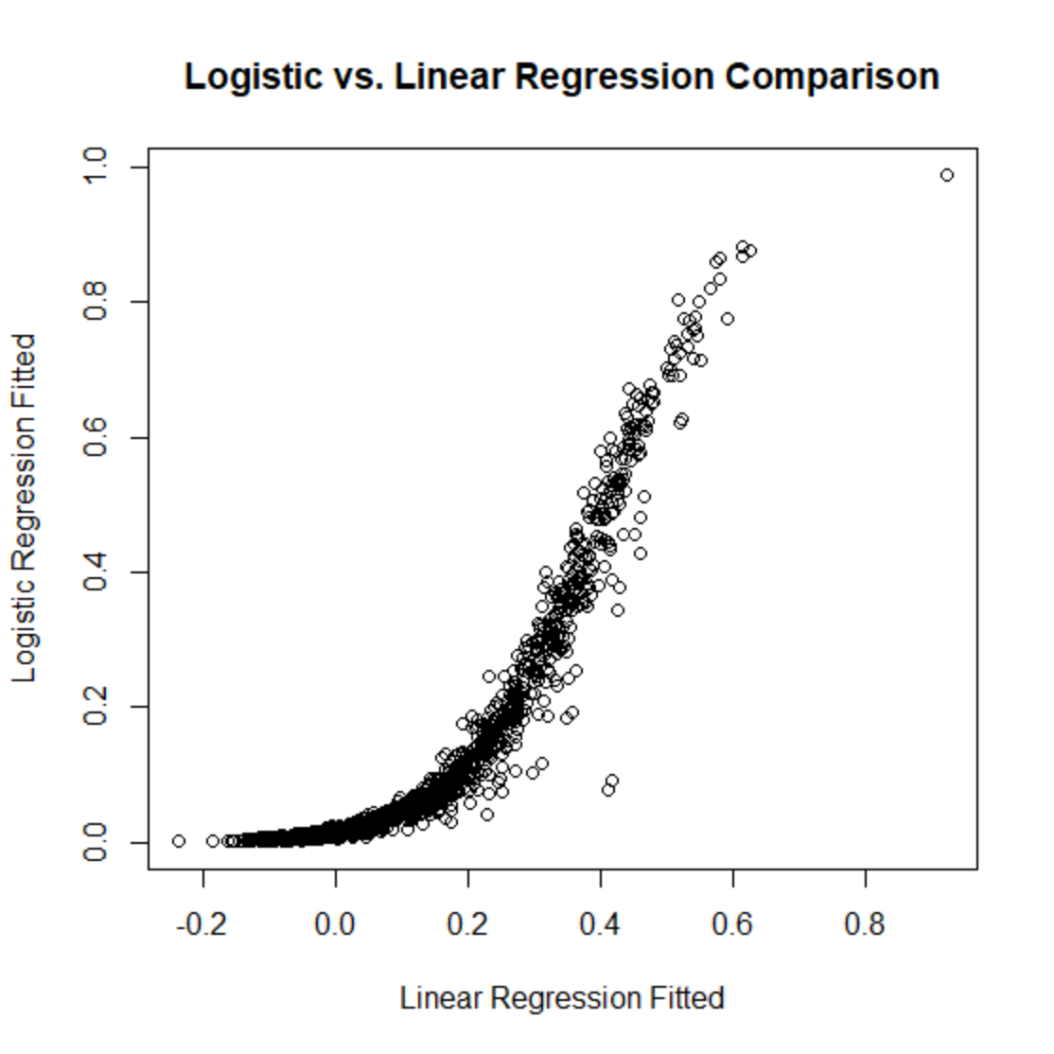
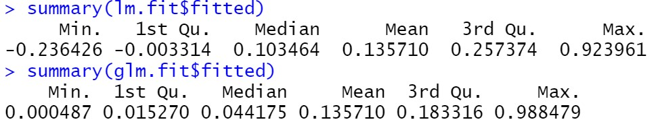
Continued… Fitted Values
Observations:
The fitted values for the mean are consistent between models.
The median, quantiles, and extremes for the fitted values are much farther apart than the mean in general.

Slide 16
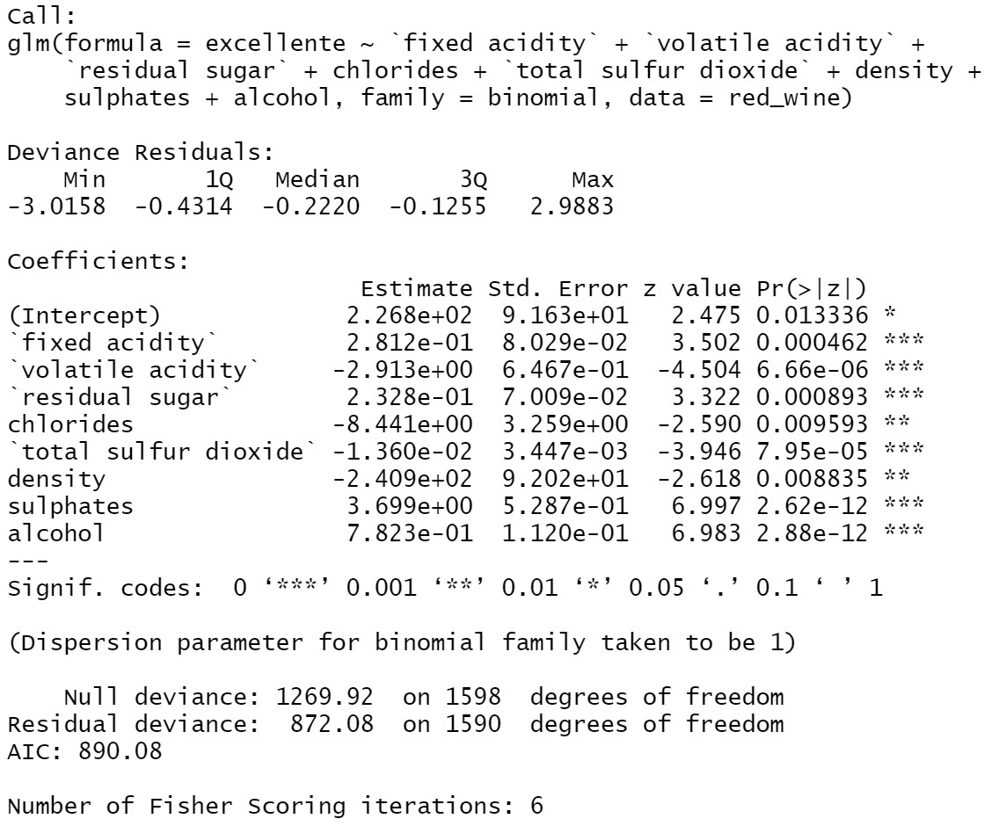
Model Selection Based On p-Values
Using the Chi-squared test, the variable with the greatest p-value is dropped, so long as it is higher than 0.05.
This process is repeated multiple times until all variables are statistically significant.
In applying this process, variables were dropped in the following order
pH
Citric Acid
Free Sulfur Dioxide
The end product to the following model on the right.

Slide 17
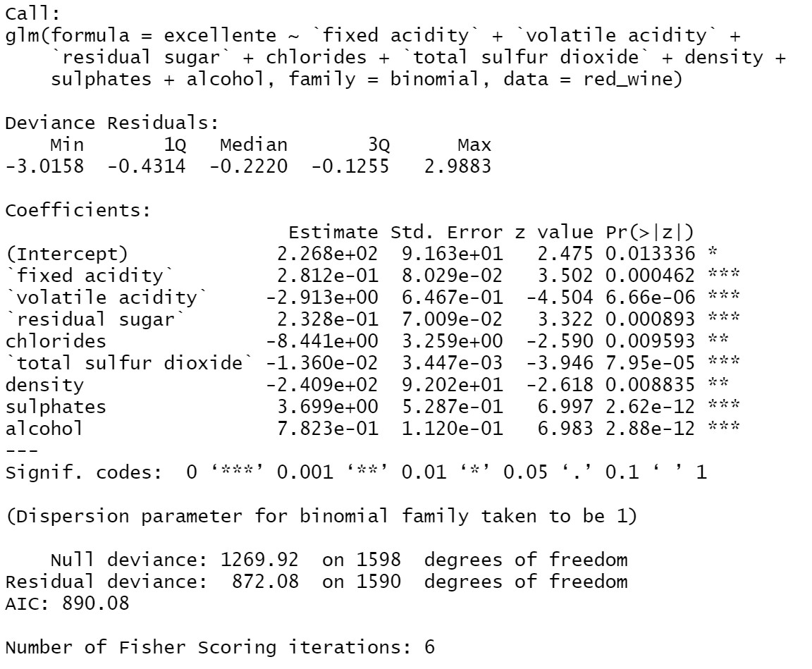
Model Selection Based On AIC
The Akaike Information Criterion (AIC) can be used as a method of choosing the optimal model.
AIC based model selection works by choosing the model with the lowest AIC value.
The model with the lowest AIC for this dataset is the model without pH, Citric Acid, or Free Sulfur Dioxide.

Slide 18
Model Selection - Assessment
Observations:
Interestingly – our variable selection based on AIC and p-values chose the same predictor variables to retain.
The variables that were removed from the full model in AIC and p-value based variable selection seemed to align with the correlated variables viewable in the correlation heap map.
When 2 variables were highly correlated, one was usually dropped resulting in less multicollinearity.
There is also a sensibility about the collinearity with one of the variables dropped – Free Sulfur Dioxide.
Total Sulfur Dioxide encompasses Free Sulfur Dioxide which causes them to be collinear.

Slide 19
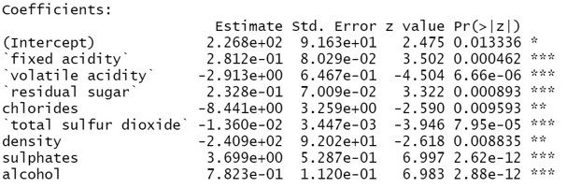
Analysis By Variable
Using the AIC and p-value variables selection models, I want to analyze the affect of Alcohol, Residual Sugar, and pH on wine quality
Alcohol
Residual Sugar
pH
Coefficient = .7823
Alcohol has a positive relationship with wine quality.
For each unit increase of alcohol, the log odds of wine quality improves by .7823.
Coefficient = .2328
Residual Sugar has a positive relationship with wine quality.
For each unit increase of alcohol, the log odds wine quality improves by .2328.
pH was removed by the process of variable selection.
pH will have no impact on our prediction using this model.

Slide 20
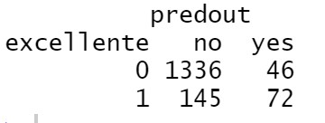
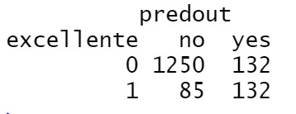
Sensitivity vs. Specificity
Using 0.5 probability threshold
Using our prediction matrix to calculate sensitivity and specificity:
Sensitivity: 1336/(1336+46) = .967
Specificity: 72/(72+145) = .332
We have very high sensitivity but poor specificity.
This means a lot of good wines are going unnoticed.
We want to find more of the excellent wines with our predictions:
This can be done by lowering the probability threshold for predicting excellent wines.
This will come at the cost of a lower sensitivity.
Using 0.3 probability threshold

Slide 21

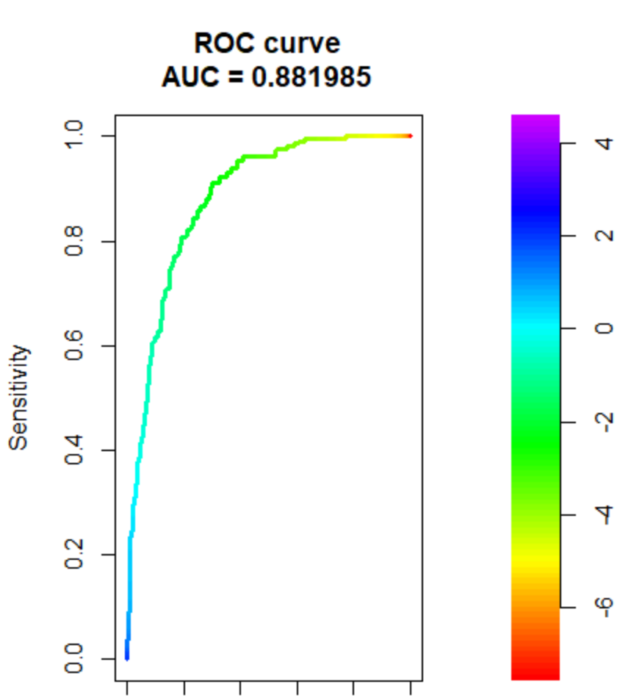



ROC Curve

Slide 22
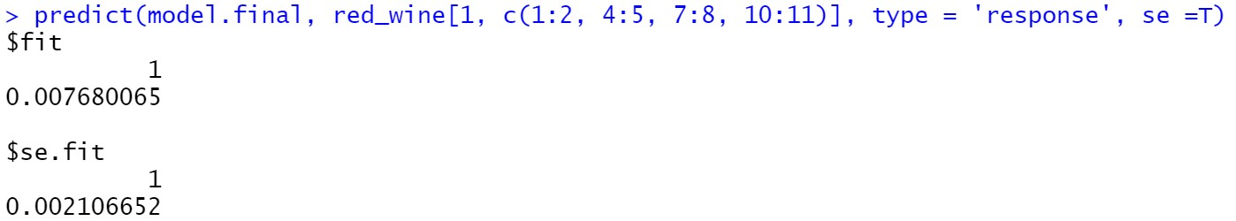
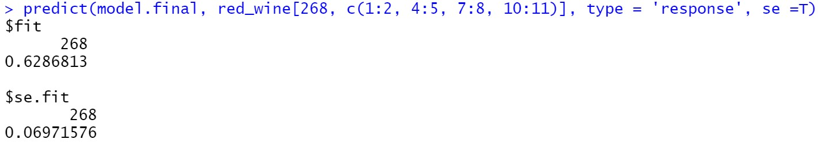
Testing The Model
The first observation has a quality rating of 5 which is not considered excellent.
Our final model predicted there is somewhere near a 1% chance it is excellent.
The CI given was between 0.004 and 0.12
The 268 observation has a quality rating of 8 which is considered excellent.
Our final model predicted there is somewhere near a 63% chance it is excellent.
The CI given was between 0.492 and 0.765
The model would correctly classify these wines with a cutoff probability of 0.

Slide 23
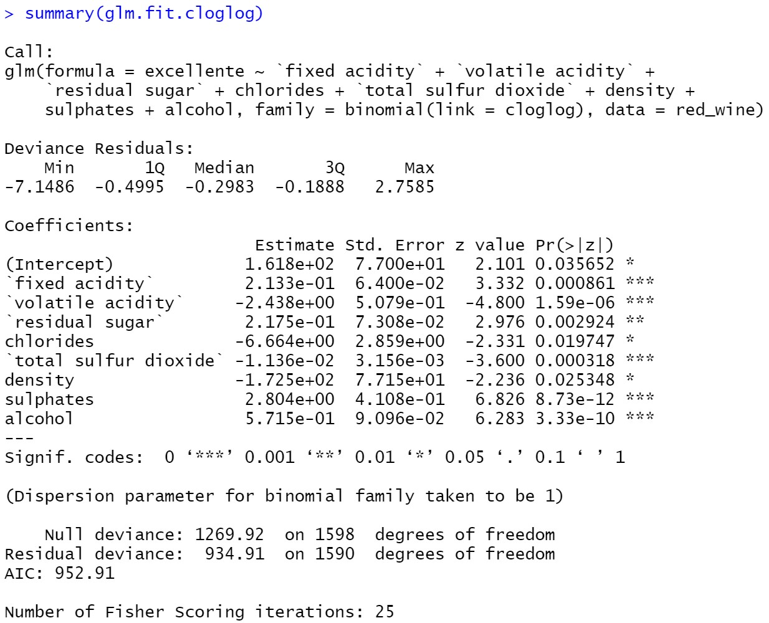
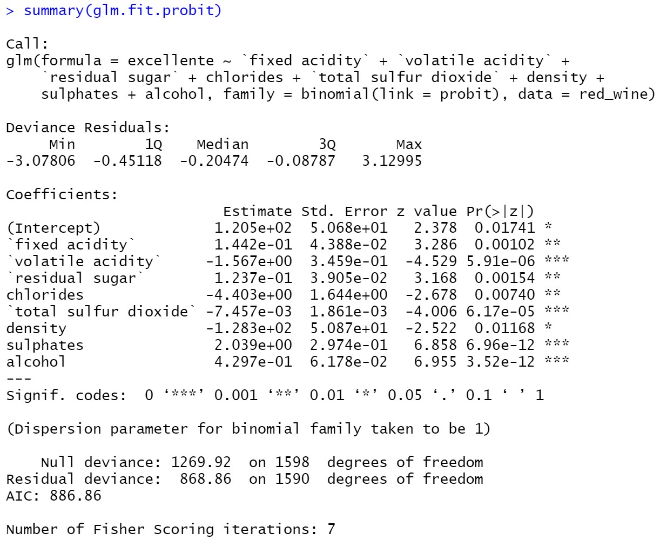
Probit & CLogLog Link

Slide 24
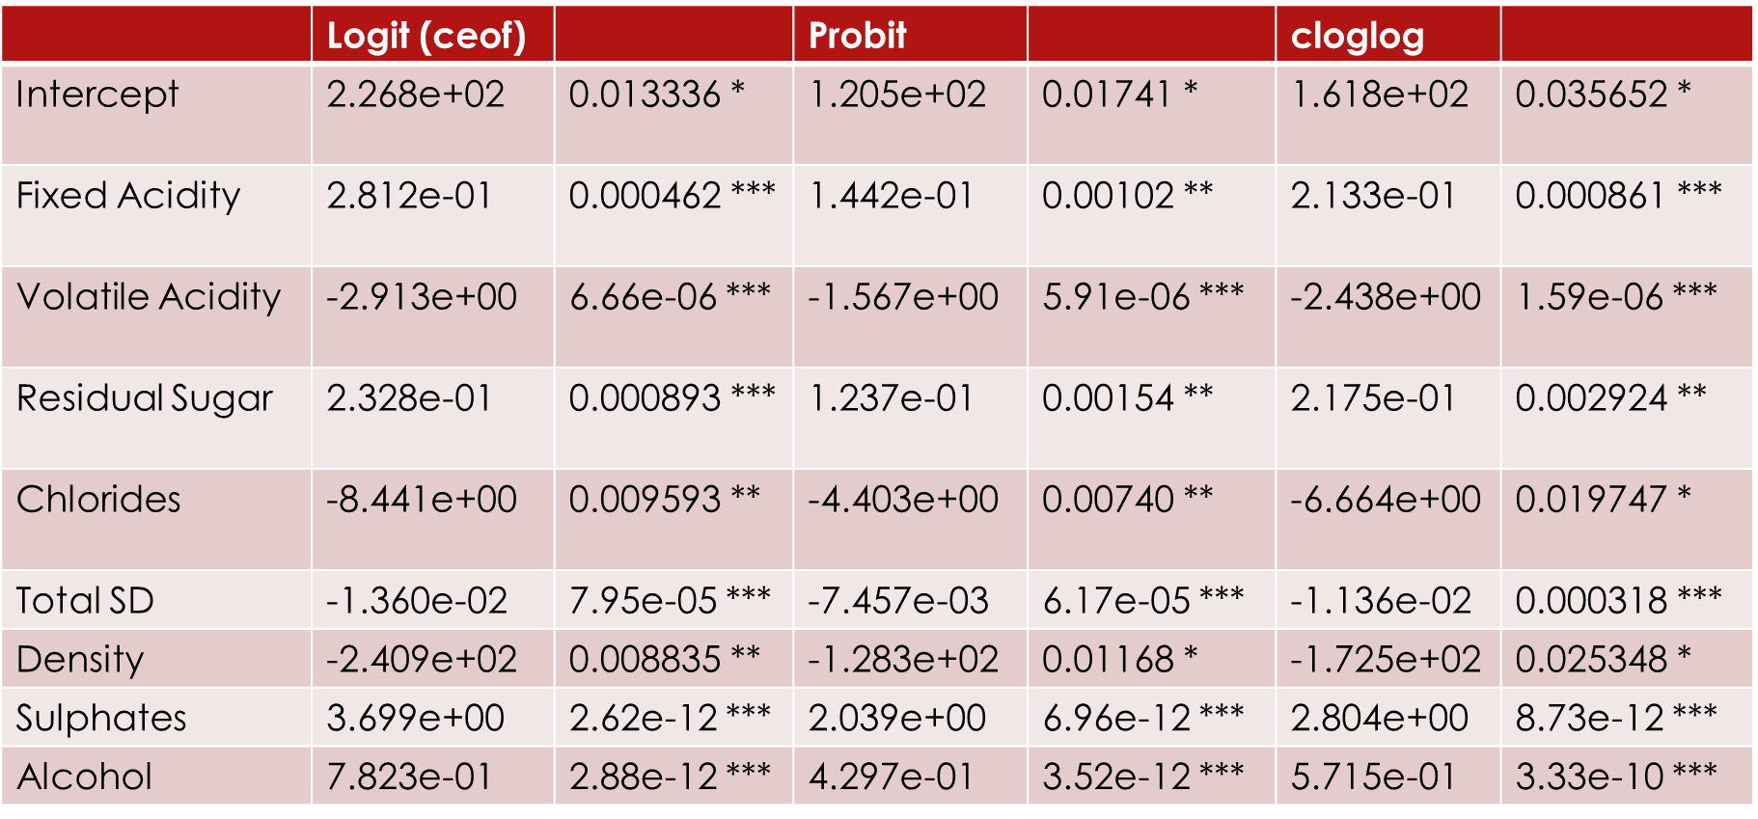
Significance

Slide 25
Model Coefficient Observations
The Logit, Probit, and CLogLog link models all had the same signs for each coefficient and intercept.
The coefficients varied between the models, however, not by much
The Logit link tended to have the highest coefficient values while the Probit link had the lowest coefficient values. This makes sense due to the logarithmic transformations.
Each model still had all significant variables. There was some slight variation between the models - > at most about an order of magnitude in the level of significance.

Slide 26
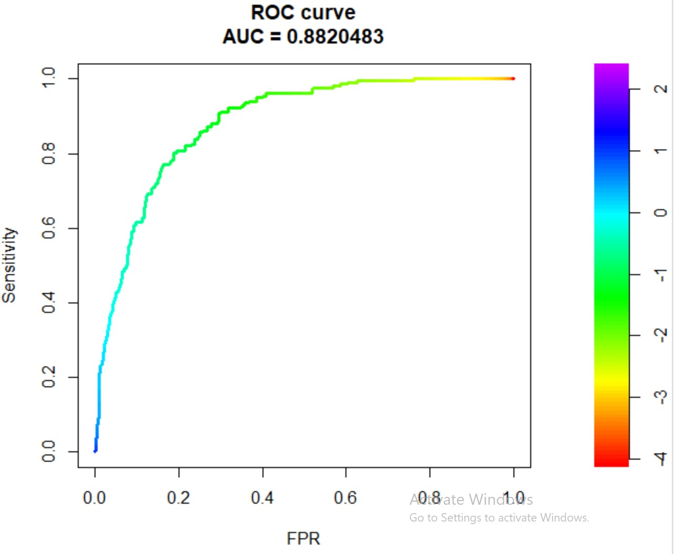
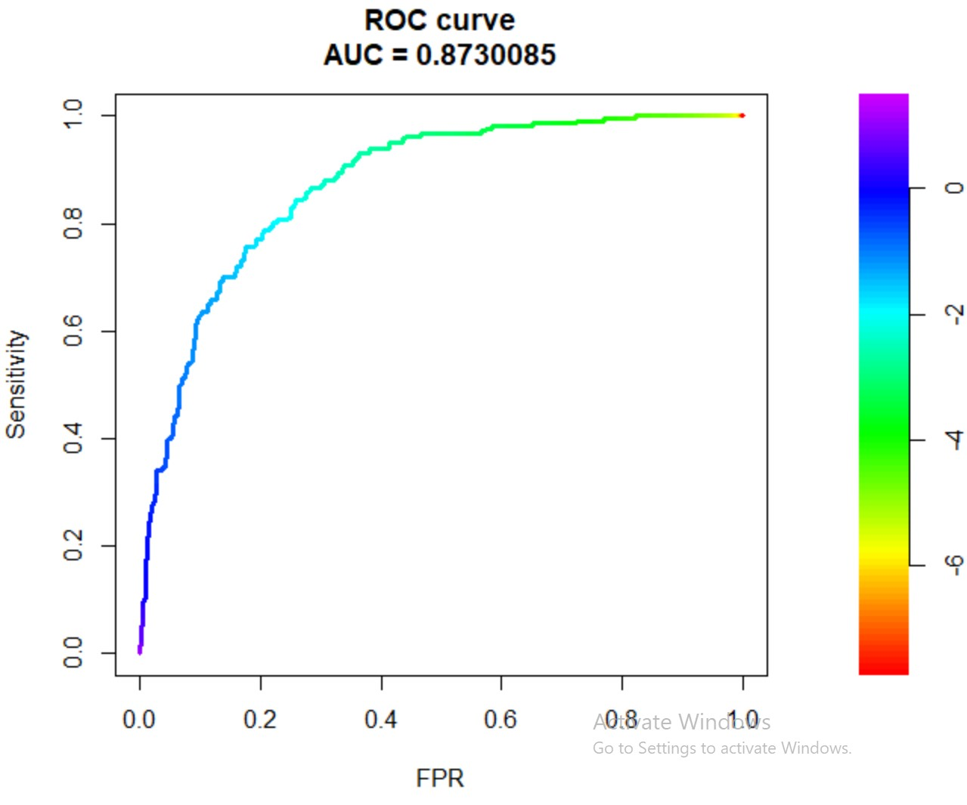
Probit (Left) and CLogLog (Right) ROC Curves

Slide 27
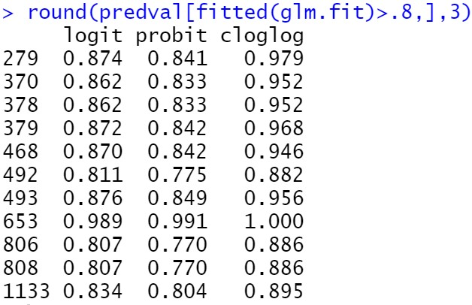
Prediction on the Upper End of the Probability Curve
The probabilities that we get on the upper end of the probability curve tend to be slightly higher for cloglog,
This is indicative of the asymmetry between cloglog and the logit and probit models in their predictions.
Because the Probit model has a slightly higher AUC than the other models, I would recommend this model to a wine expert to have the best chance of picking a quality wine.

Slide 28

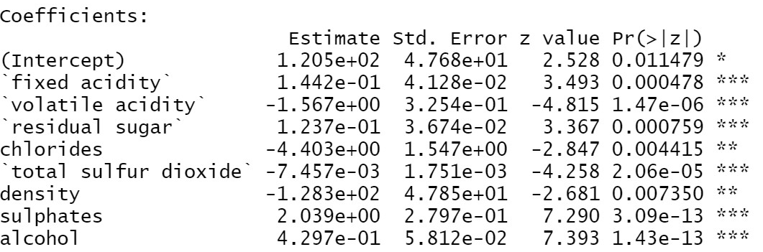
Dispersion Adjustment
Probit Regression
Probit Regression –> Dispersion = 0.885
The original Probit Regression model was slightly over dispersed, so a new model has been created with an adjusted dispersion parameter.
The new model with the adjusted dispersion parameter was different in that it has a lower standard error for each coefficient as well as more significance associated with each estimate.
What has stayed the same between the models are the coefficient estimates themselves.

